Slide 1
COMPUTER NETWORKING
TOPIC- MULTIPLEXING
PRESENTED BY – SHREYA MUKHERJEE.
DEPT – CSE
ROLL - 16800117020

Slide 2
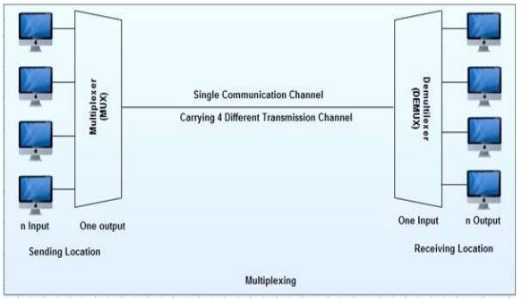
WHAT IS MULTIPLEXING ??
Multiplexing is a technique used to combine and send the multiple data streams over a single medium. The process of combining the data streams is known as multiplexing and hardware used for multiplexing is known as a multiplexer.

Slide 3
Why Multiplexing?? The transmission medium is used to send the signal from sender to receiver. The medium can only have one signal at a time. If there are multiple signals to share one medium, then the medium must be divided in such a way that each signal is given some portion of the available bandwidth. For example: If there are 10 signals and bandwidth of medium is100 units, then the 10 unit is shared by each signal. When multiple signals share the common medium, there is a possibility of collision. Multiplexing concept is used to avoid such collision.

Slide 4
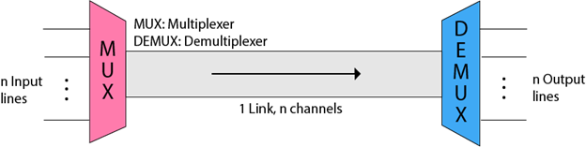
Concept of Multiplexing ?
The 'n' input lines are transmitted through a multiplexer and multiplexer combines the signals to form a composite signal.The composite signal is passed through a Demultiplexer and demultiplexer separates a signal to component signals and transfers them to their respective destinations.

Slide 5
Advantages of Multiplexing:
More than one signal can be sent over a single medium.
The bandwidth of a medium can be utilized effectively.

Slide 6
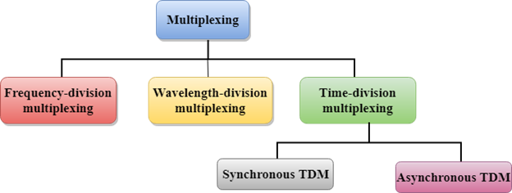
Multiplexing Techniques :

Slide 7
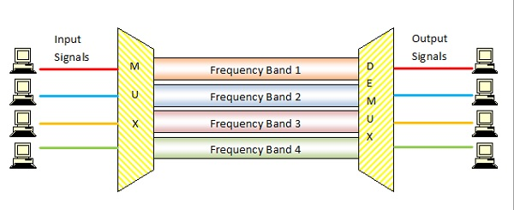
Frequency Division Multiplexing
When the carrier is frequency, FDM is used. FDM is an analog technology.
FDM divides the spectrum or carrier bandwidth in logical channels and allocates one user to each channel. Each user can use the channel frequency independently and has exclusive access of it.

Slide 8
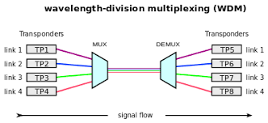
Wavelength Division Multiplexing
Wavelength division multiplexing (WDM) is a technique of multiplexing multiple optical carrier signals through a single optical fiber channel by varying the wavelengths of laser lights. WDM allows communication in both the directions in the fiber cable.
In WDM, the optical signals from different sources or (transponders) are combined by a multiplexer, which is essentially an optical combiner. They are combined so that their wavelengths are different.

Slide 9
Time Division Multiplexing
TDM is applied primarily on digital signals but can be applied on analog signals as well. In TDM the shared channel is divided among its user by means of time slot. Each user can transmit data within the provided time slot only. Digital signals are divided in frames, equivalent to time slot i.e. frame of an optimal size which can be transmitted in given time slot.
There are two types of TDM:
Synchronous TDM
Asynchronous TDM

Slide 10
Synchronous TDM
1. In synchronous TDM, each device is given same time slot to transmit the data over the link, irrespective of the fact that the device has any data to transmit or not. Hence the name Synchronous TDM. Synchronous TDM requires that the total speed of various input lines should not exceed the capacity of path.
2. Each device places its data onto the link when its time slot arrives i.e. each device is given the possession of line turn by turn.
3. If any device does not have data to send then its time slot remains empty.
4. The various time slots are organized into frames and each frame consists of one or more time slots dedicated to each sending device.
5. If there are n sending devices, there will be n slots in frame i.e. one slot for each device.

Slide 11
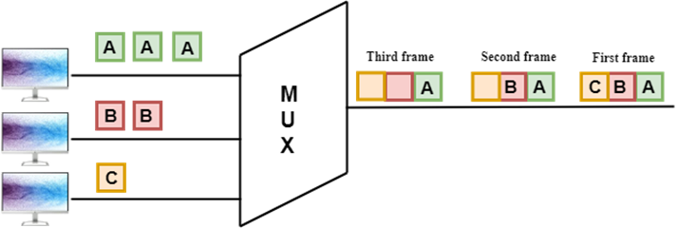
Synchronous TDM

Slide 12
Asynchronous TDM
An asynchronous TDM is also known as Statistical TDM.
An asynchronous TDM is a technique in which time slots are not fixed as in the case of Synchronous TDM. Time slots are allocated to only those devices which have the data to send. Therefore, we can say that Asynchronous Time Division multiplexor transmits only the data from active workstations.
An asynchronous TDM technique dynamically allocates the time slots to the devices.
In Asynchronous TDM, total speed of the input lines can be greater than the capacity of the channel.
Asynchronous Time Division multiplexor accepts the incoming data streams and creates a frame that contains only data with no empty slots.
In Asynchronous TDM, each slot contains an address part that identifies the source of the data.
The difference between Asynchronous TDM and Synchronous TDM is that many slots in Synchronous TDM are unutilized, but in Asynchronous TDM, slots are fully utilized. This leads to the smaller transmission time and efficient utilization of the capacity of the channel.
In Synchronous TDM, if there are n sending devices, then there are n time slots. In Asynchronous TDM, if there are n sending devices, then there are m time slots where m is less than n (m<n).
The number of slots in a frame depends on the statistical analysis of the number of input lines.

Slide 13
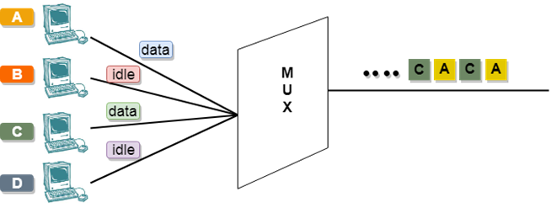
Asynchronous TDM

Slide 14
THANK YOU FOR WATCHING

